Slide 1
Lecture8 Outline
IS resource Management
  An amalgamation of disciplines, where does IS strategy fits? Four paradigm shifts, creating new challenges and opportunities, The new enterprise, Hierarchical vsOpen-networked organization, the 3 shift in the application of IT, critical technology shift, Political models of IT management etc
Student: Listen, contribute & prepare a good summary of the lecture.
Independent study: Read the next slide for the next lecture.

Slide 2
An Amalgamation of Disciplines
Psychology
Computer
Science
Sociology
Management
Science
Business

Slide 3
Management of
information technology
policy and strategy
Planning
Organizational
structure
Operations
Applications
Encouraging
users
Information
systems
architecture
Systems
analysis and
design
Database
Impact on the
organization
Information
systems
technology
Evaluation
and control

Slide 4
Where does IS Strategy fit ?
Vision for the Organization
and Information Technology
IT and Organization Structure
IT Strategy
Corporate Strategic Plan
Integration of
IT and Decision
Making
Alliances &
Partnerships
IT Initiatives
IT Infrastructure
Ongoing IT
Operations

Slide 5
Four Paradigm Shifts
New Business Environment
  Open, Competitive, Dynamic Marketplace
New Enterprise
  Open, Networked, Information-based Organization
New Geopolitical Order
  Open, Volatile, Multipolar World
New Technology
  New Goals of IT
  Open, User-centered, Networked Computing
Notes:
18
Impacting Today’s Business Environment

Slide 6
Creating New Challenges and Opportunities
Productivity of Knowledge and Service Workers
Quality Emphasis
Responsiveness to the Marketplace
Globalization
Outsourcing
Partnering
Social and Environmental Responsibility
Notes:
Business Environment Changes

Slide 7
The New Enterprise
Hierarchical Structure Ill-suited
  Seek to separate governed from governors
  Middle managers act as a communication channel between top and bottom
Information Technology has replaced these ‘human relays’
Flatter, Leaner Organizations Result

Slide 8
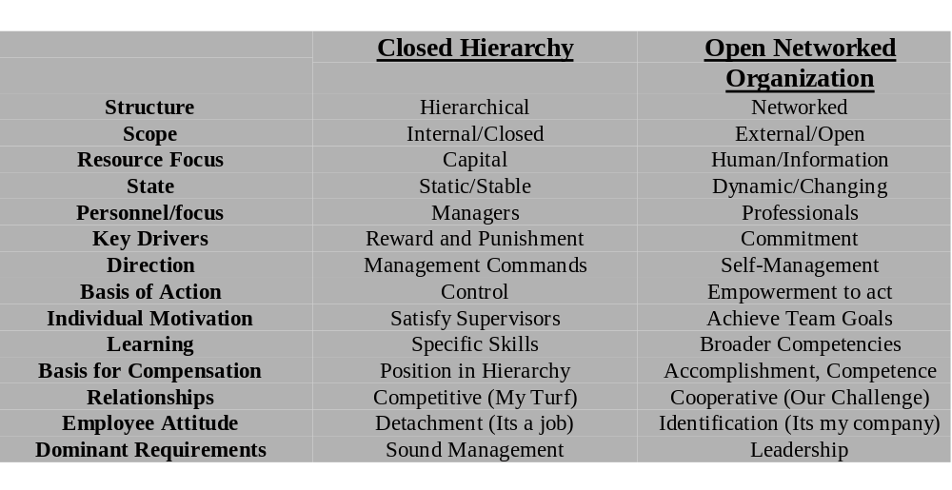
Hierarchical vs. Open-Networked Organizations

Slide 9
Three Shifts in the
Application of IT
From Personal to Work-Group Computing
From Systems Islands to Integrated Systems
  Management and control of physical assets and facilities
  Financial management and control systems
  Technologies to manage and support human resources
From Internal to Inter-enterprise Computing

Slide 10
Critical Technology Shifts
From Traditional Semiconductors to Microprocessor-Based Systems
From Host-based to Network-based Systems
From Vendor Proprietary Software to Open Software Standards
From Single to Multimedia - Data, Text, Voice, and Image
From Account Control to Computer Vendor- Customer Partnerships Based on Free Will
Software Development - From Craft to Factory
From Alphanumeric to Graphical, Multiform User Interface
From Stand-Alone to Integrated Software Applications

Slide 11

Political Models of IT Management
Lucas, 1999

Slide 12
IS Resource/User relationship
Service model
  Interaction is a service obligation
Partnership model
  IS resource not separated
Vendor model
  IS resource sells services
Expansion model
  IS creates a flexible architecture to allow for growth
Strategic advantage model
  Competitive products are developed jointly
Notes:
Service model more older style organisations or where organization is trying to catch-up. IS resource does it to them.
Partnership model breaks down separation between IS and business users. Do it with them
Vendor model sells services to business users. Do it for them
Expansion model create an expansible architecture to accommodate growing requirements.
Strategic model do it with them

Slide 13
Roles of the IS function
IS infrastructure
  Backbone services
  Security
  Network management
  Database management
  Collaborative working
Long term R&D
  IS Strategy
Facilitating end-user computing
  User Support
  Consultancy
Notes:
IS Infrastructure : delivering backbone services in cost effective and reliable way. Security by backups, access control, error detection, archiving.
Long term R&D : r&d into technical directions. Proactive not reactive
Facilitating end-user computing : user support. Assistance in selecting and using IS.

Slide 14
Location of IS Resource
Need to decide appropriate location of IS elements
  Centralized
    IS resource provides on single service
  Decentralized
    IS resource constitutes a number of smaller single-site, single-access centres
  Devolved
    IS resource is a web of geographically and managerially dispersed centres with significant degree of end-user control over processing and application development and environment
Notes:
There is an argument that the structures of the IS resource should mirror the organization structures. Not always possible. In addition there is a discussion about location.
Used to be a discussion on whether resource should be centralized or decentralized, now become a debate on what aspects to keep centralized.
Devolved is real opposite of centralized.
Talking about more than hardware siting. Need to look at the siting of each component : what to decentralise, how and to what extent.

Slide 15
Centralized IS Location
Benefits
  Greater control
  Reduced duplication of effort, resources and expertise
  Capacity to handle large and complex projects
  Reduced potential for incompatibility
  Generally easier to recruit and manage specialised staff
  Support cross-department systems
Notes:
Greater control systems production, database integrity and security
Reduced duplication economies of scale, overall organisational cost savings
Capacity to handle large projects maintain pool of experienced staff and shared resources
Cross-department umbrella for all business processes

Slide 16
Centralized IS Location
Drawbacks
  IS function removed from business
  Little scope for personal attention
  Can be dis-economies of scale
  Access can be slow
  Danger of unfairness
  Communication costs can be high
Notes:
IS separation : removed from concerns and priorities of business. Can cause hostility
Personal attention: mass market provider rather than specialist provider. Can cause business priorities to be ignored
Dis-economies of scale: general policies rather than specific. Solutions may not suit individual business requirements
Access slow: both in terms of processing an in terms of access to development services
Unfairness: again general charging mechanisms
Communication costs: physical communication costs.

Slide 17
Situations that could require Centralized Location
Senior Management IS
Common Services
Small business units
Integration
Non-critical Response time
Consistency with IS Objectives
Notes:
Senior MIS : will probably be complex and draw on information that needs to be protected
Common services: if common to a number of business units it makes sense to site it centrally
Small units: may not be cost effective for each unit to develop and manage their own Is
Integration:total integration of data vital to an organization and there are technical complications inherent
Response time not critical: speed not a business requirement
Consistency with IS Objectives: goals relating to efficiency

Slide 18
Decentralized IS Location
Benefits
  Data recording close to event
  End-user gains autonomy
  May lower data communication costs
  Allows effort and resources to be targeted appropriately
  IS development should be more integrated with business
  Increased user perception of cost/benefit trade-offs
Notes:
Considering both decentralized and devolved
Difference between decentralized and devolved is the level of dispersion of control and authority
Data recording: risk of errors in understanding lower, less user-resistance likely
Autonomy : units accept higher costs in compensation for greater responsiveness
Lower data communication costs: systems generally less complex and easier to control
Effort and resources: focused nature of service
Integrated with business : most reactive to business needs. Physically and mentally closer to end-users
Increased perception of cost-benefit analysis :

Slide 19
Decentralized IS Location
Drawbacks
  Higher overall costs
  Higher risk of future incompatibility
  Can deal with limited complexity
  Career paths can be limited
  Duplication of operations
  Process of devolution may cause hostilities
Notes:
Higher costs: cost may be lower for the particular business unit but higher overall. May be balanced by gains.
Incompatibility: not technically necessarily but information and human resources
Limited complexity: smaller IS units implies less specialised experience etc
Duplication of operations: must be some degree of duplication and therefore inefficiency
Hostilities: usually moving from a centralized computing resource to a devolved
These disadvantages plus the advantages of centralized computing are what determines what should be kept central or not. A range of approaches are needed.

Slide 20
Principles for successful use of non-centralized IS Resource
Supported from top
Responsibility and authority delegated and assigned to appropriate management
Decentralisation co-ordinate and controlled in formalised manner
Top-level co-ordination committee
Corporate retention of key functions and activities
Decentralized decisions made on business unit by business unit, function by function, system by system basis
Central IS provider influences the devolved elements by persuasion and example rather than coercion
Notes:
Danger with decentralized is that the organization cannot get a unified view of itself or its business which is vital for effective competition in the global markets of today.
At least some part of the IS resource should be centrally located in order to support the notions of BPR and organizational learning

Slide 21
Centralized v Decentralized
Centralized
  Cost saving benefits
  Lack of significant data communications
  Need for tight control
  Lack of need for business responsiveness
Decentralized
  Speed and flexibility
  Unique service
  Consistency with IS objectives
Notes:
Decentralized
Speed and flexibility : most frequent driver

Slide 22
Commercialising IS Function
Must have
  A clearly defined mission and objectives understood and accepted by all
  Clear leadership from someone who understands the business environments
  Acceptance that customers determine a business’ future
  A competitive edge to keep customers faithful and happy with service
  An honest view of strengths and weaknesses
  Identification of competition and knowledge of the basis of competition
Concerned with ability
  Sell services
  Price services
  Forecast service trend
  Contract service quality
Notes:
46
Trend towards organisations considering whether they should have an IS resource internally at all
Setting up IS to contract its services as a separate company
Way of forcing IS to be customer responsive in a commercial way usually associated with SLAs of some description
Internal IS resource will be in competition with potential service providers and so must woo internal customers
Tendering

Slide 23
Outsourcing IT
Often associated with downsizing
If core business is not IS should this function not be outsourced ?
Impacts significantly on
  IS functional structure
  The nature of the IS manager
  The strategy for acquisition of services
IS resource is now a management function not a service provider
Notes:
48
Closely related to downsizing or divesting to concentrate on core competencies
Will look more at outsourcing in next couple of lectures

Slide 24
Organisation of IS Resource
Traditional (1960s)
  Rigid structure separating responsibility for various required tasks
  Worked well for centralized batch-operated systems but increasingly unworkable over time
  Supports specialisation
  Disadvantages:
    Development backlogs
    Proscribed systems
    Inflexible systems
    Expensive maintenance
Database driven structure (1970s)
  Data removed from applications
  Users take more responsibility for data entry
  Quicker system development, more flexible systems
  IS staff grouped round data areas
  Users increasingly involved
Notes:
49
Going to look at the internal management structure of the IS resource itself
Taxonomy very much linked to evolution of computing technologies
Traditional: oldest. Really a data processing department or computer section. 1960s.
Rigid structure.
Proscribed systems : is department knows best mentality
Database Driven

Slide 25
Organisation of IS Resource
Functional Project Groups (1980s early)
  Combine analysts and programmers into function-based project groups
  Recognises business purpose, focus on demand issues
  Can make it difficult to determine responsibility and career progression
  Increased user involvement
  More business awareness in IS staff
Information centres and decision support (1980s mid-late)
  Method of organising one IS resource widely used to support user-controlled computing
  Centralise certain IS functions and devolve others
  Decision support
  End-user controlled computing
  Hybrid IS Resource
Notes:
49
Organising IS to support management decision making
IS staff grouped to match decisions made within the enterprise itself

Slide 26
Organisation of IS Resource
Externally focused (1990s early)
  Focus on the environment in which organization exists
  Structured around customer service lines
  Service Level Agreements important
  Concerned with devolving autonomy to achieve shorter application development cycles, more flexible systems
  IS structures tend to be poorly defines
Notes:
49

Slide 27
Choosing location and organization
Is the IS resource in tune with the corporate strategy ?
Is the IS resource in tune with organisational shape ?
Is this element of the IS resource to be inward looking ?
Is this element of the IS resource to be externally focused ?
Notes:
50
IS resource need not mimic functional business structures but should be consistent with them

Slide 28
Symptoms of structural misfit
Continual conflict
Continual complaints about IS
Competitive decline
Lack of interest in IS
Skills problems
High staff turnover
Gaps and overlaps
Notes:
52
Unlikely to have all symptoms at one time

Slide 29
END

Slide 30
15. Managing IS Resources
Notes:
IS Strategy forms a benchmark against which policy choices and decisions can be judged.
Four major areas of strategy choice.
IS strategy gives a template against which to test the implications of a given decision
Over next few lectures will discuss policy decisions that emerge as an organization formulates an IS strategy

Slide 31
15. Managing IS Resources

